Slide 1

ODBC2KML Requirements Meeting
PolyTech Industries, Inc.
November 5, 2009

Slide 2
Project working structure
Two weekly group meetings
Weekly reports are submitted explaining the progress made on that week
Used to keep track of project schedule and time management
Log is maintained for every activity in the group
Each person is assigned equal amount of work
Peer evaluations are done after every document

Slide 3
Where are we standing?
Project Proposal – Hours spend on average 20
Project Plan – Hours spend on average 14
Conops – Hours spend on average 16
HCI -Hours spend on average 23
SRS – Hours spend on average 24
ATP – Right now we are working on it

Slide 4
Impacts of this course
Every document goes through multiple revisions
Make students to understand whole SE process
Builds a good working team relationship
ODBC to KML project makes them to think and work on certain things that they have not covered in courses
Gives them a kind of real world development experience
Really,a fun experience for all

Slide 5
Major Functions
Create Connection
Edit Connection
Delete Connection
Generate KML File
Web Service
Web Application
Preview KML on Google Maps

Slide 6
List of Requirements
Create Connection
Edit Connection
Delete Connection
View Connection

Slide 7
Requirements, cont.
Map database fields to KML fields
View Values from Database Tables
Set Description
Insert field value into KML description
Insert picture into KML description

Slide 8
Requirements, cont.
Upload an Icon from User’s Computer
Upload an Icon from the web
Add an icon to the connection
Select Icon overlay color
Set icon condition

Slide 9
Requirements, cont.
Generate KML from Web Service
Generate KML from Web Application
Retrieve an image from a web service
Preview KML on Google Maps

Slide 10
HCI

Slide 11
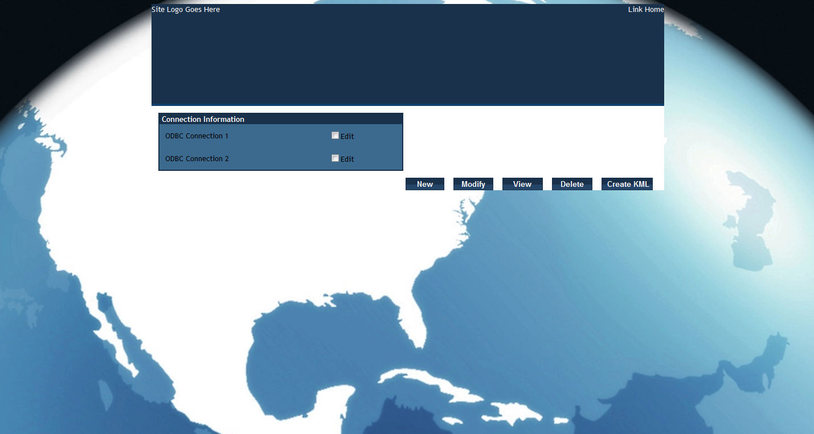
Main Page Screenshot

Slide 12
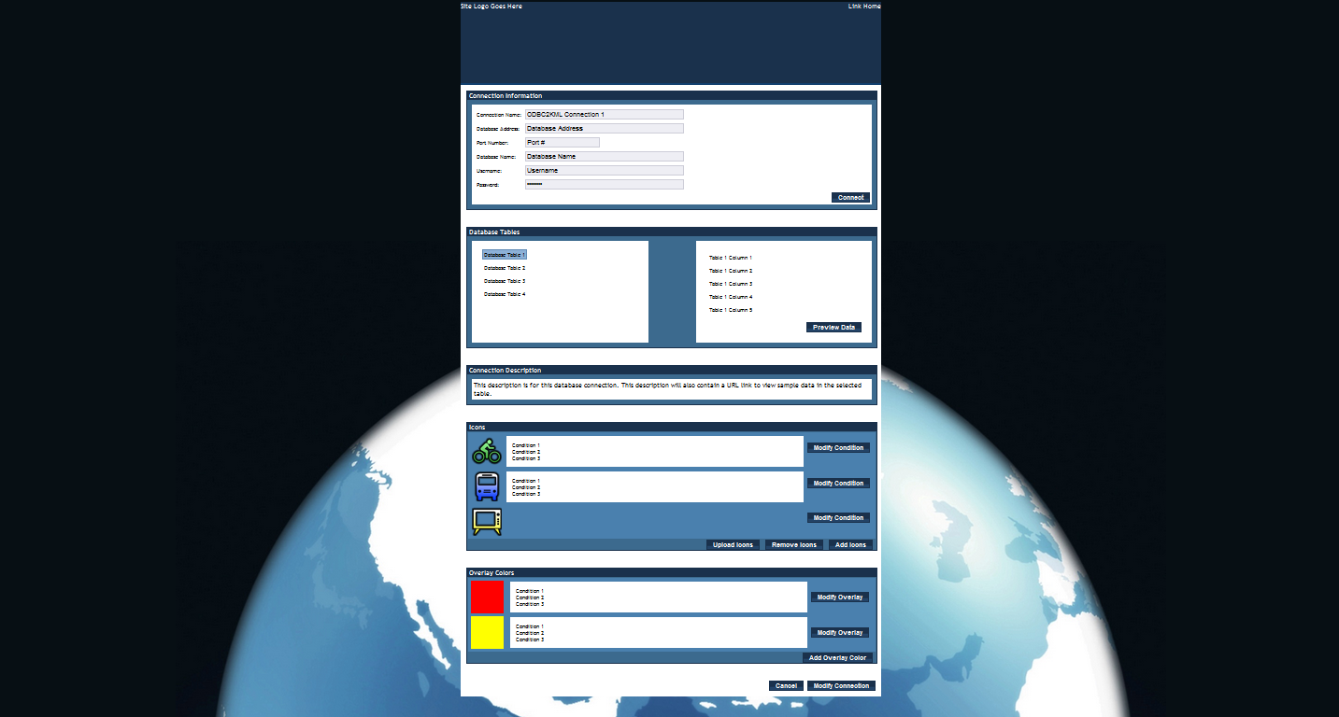
Overall View of Create/Mod/View

Slide 13
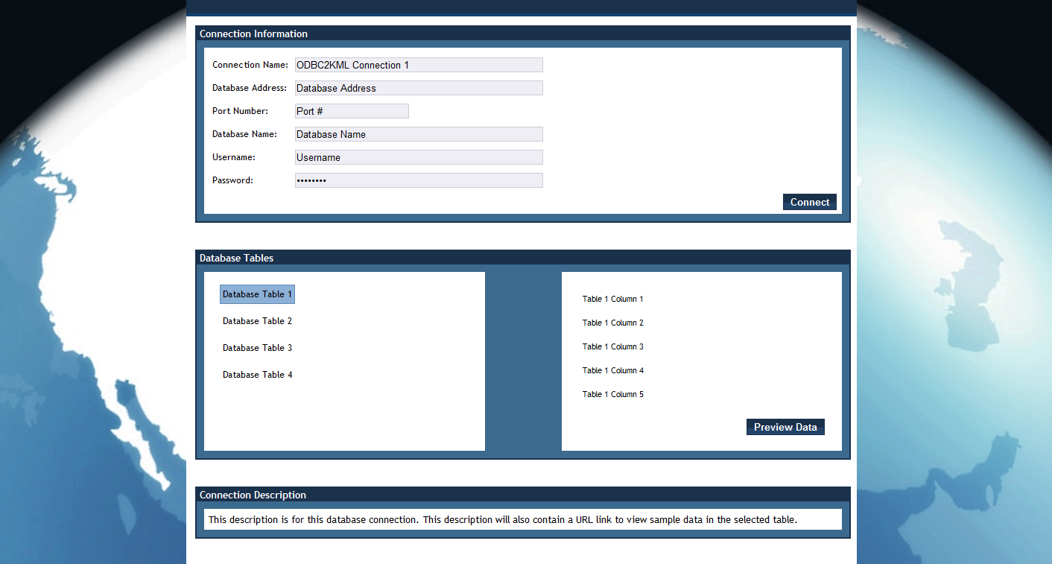
Conn/Database/Desc SS

Slide 14
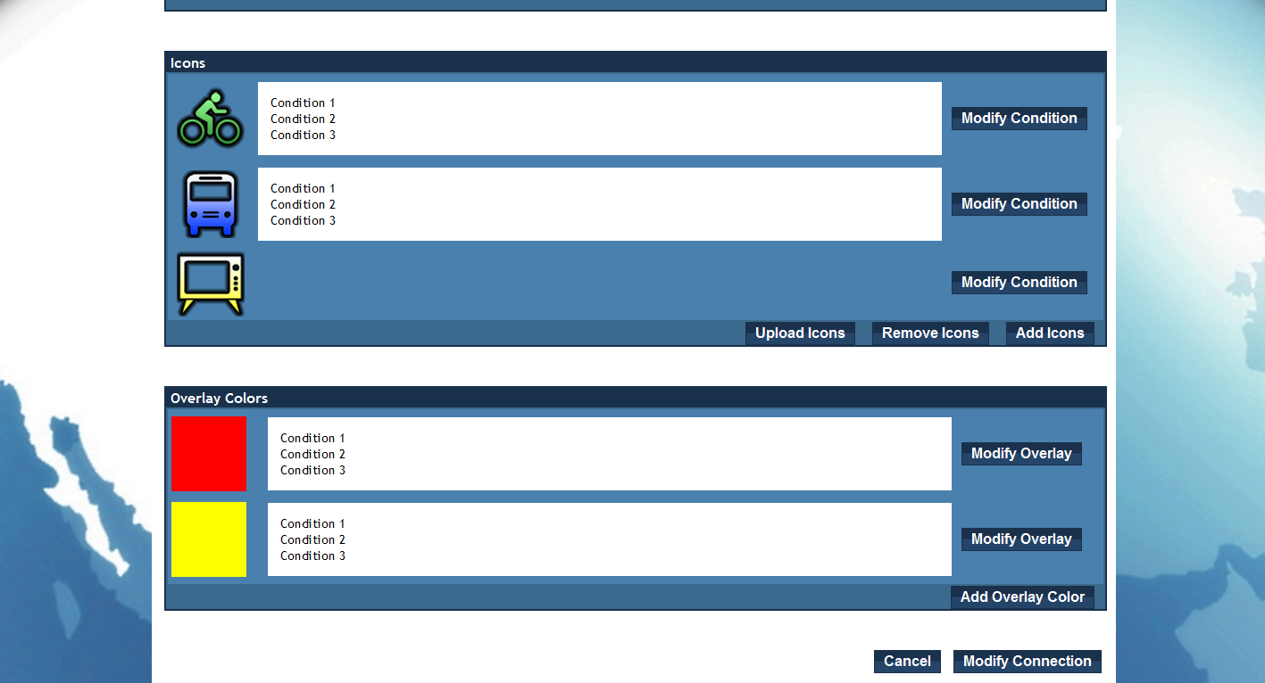
Overlay/Icon Screenshot

Slide 15
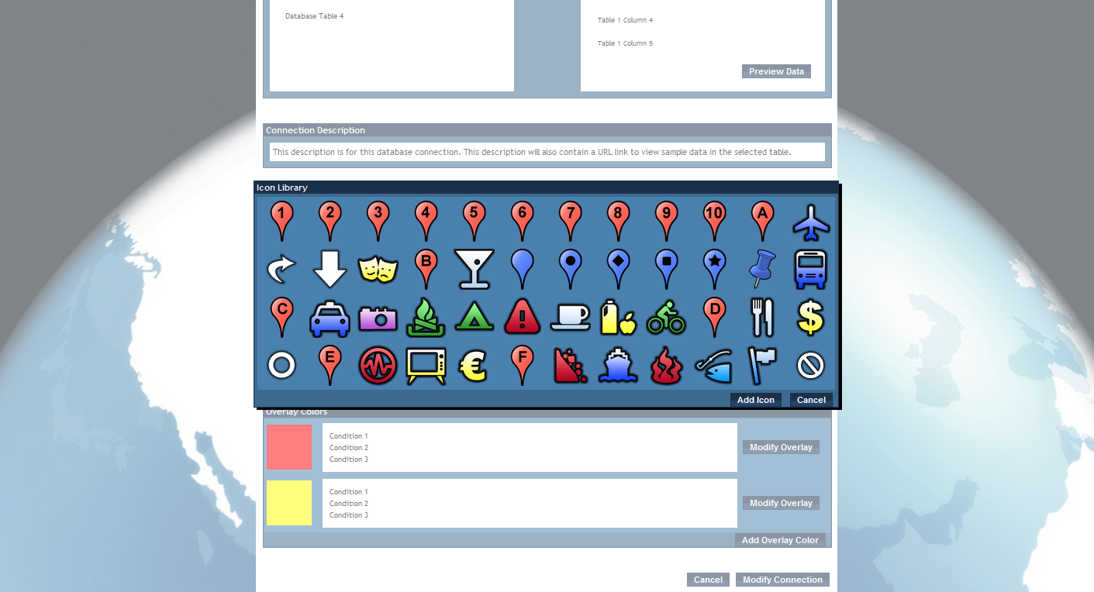
Icon Library

Slide 16
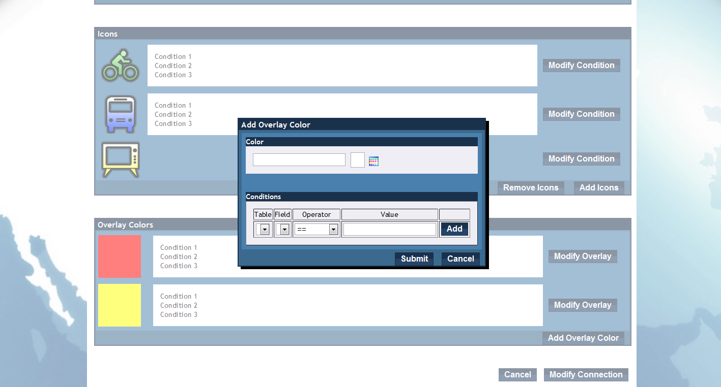
Overlay Screenshot

Slide 17
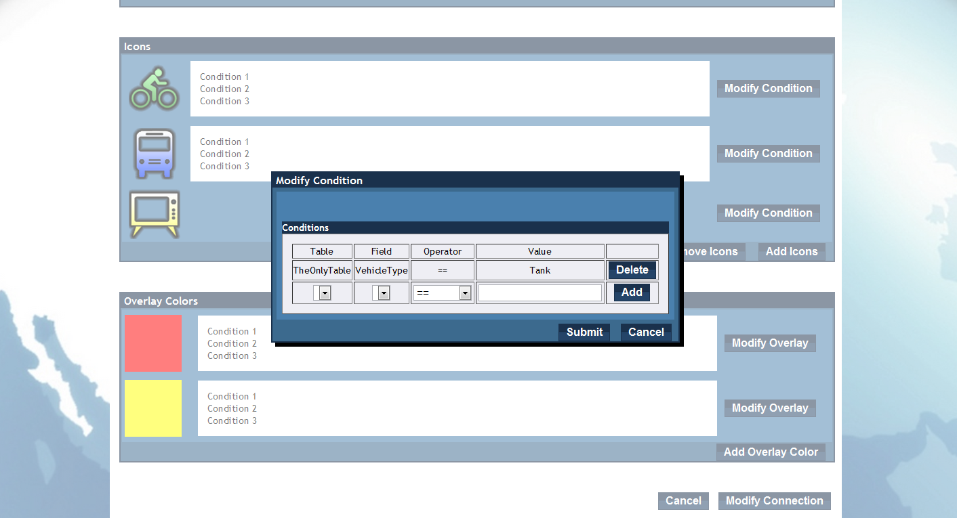
Modify Condition Screenshot

Slide 18
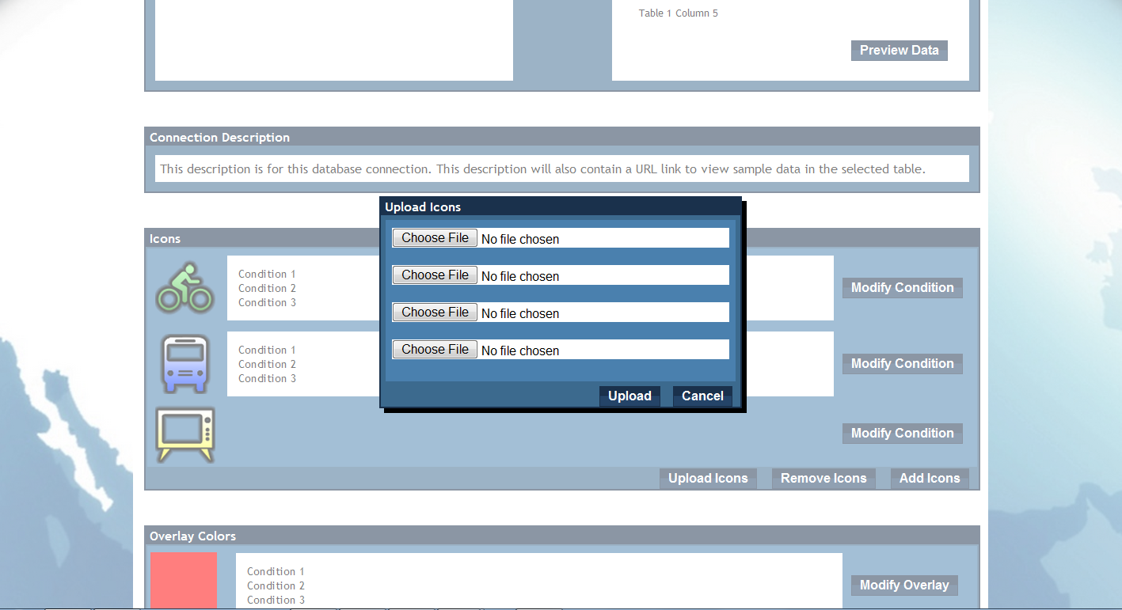
Upload Icon

Slide 19
Questions for the Client
Error logging
Color overlays
Individual descriptions for table rows
Support for multiple tables per connection

Slide 20
Planned Work
Software Architecture Document
Interim Report
Requirements Revision

Slide 21
Questions?

